Slide 1
Why all that hype about topologically associated domains (TADs)?
Cyril and Jennifer
Marques Group Meeting
09 Dec 2016
Notes:
1

Slide 2
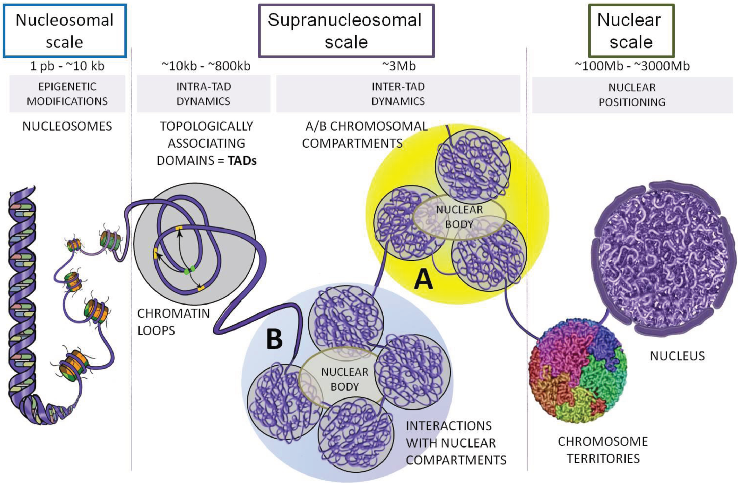
The 3D genome
Ea V, Baudement MO, Lesne A, Forné T. Contribution of Topological Domains and Loop Formation to 3D Chromatin Organization. Genes (Basel). 2015;6(3):734-50.

Slide 3
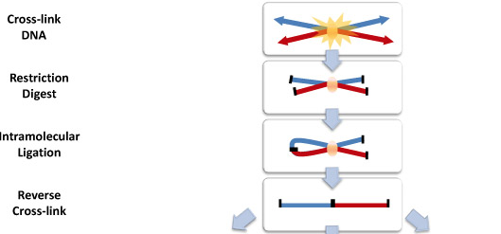
Chromatin Conformation Capture
Used to measure proximity of genomic regions in space
Common basis for all “C” techniques:

Slide 4
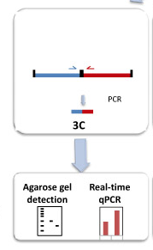
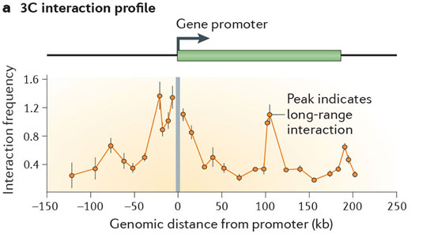
3C
Chromosome
Conformation
Capture
“One versus one”
Real-time PCR for quantification of ligation product
Requires knowledge of both interacting loci for primer
design.

Slide 5
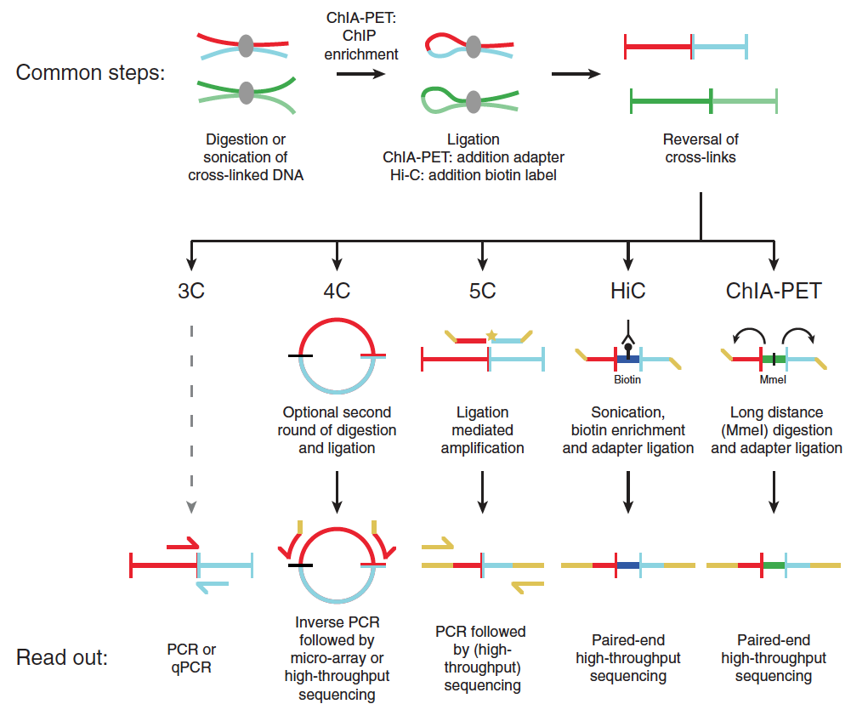
4C
Circularized
Chromosome
Conformation
Capture
“One versus all”
Ligation products are circularized
Inverse PCR: Only requires knowledge of 1 locus
Readout on micro-array or
high-throughput sequencing
Noordermeer D, Duboule D. Chromatin looping and organization at developmentally regulated gene loci. Wiley Interdiscip Rev Dev Biol. 2013;2(5):615-30.

Slide 6
Carbon
Copy
Chromosome
Conformation
Capture
5C
“Many versus many”
Needs primers for all restriction fragments
Unsuitable for whole genome analyses
Maps interactions between all restriction fragments within a given region
Dekker J, Marti-renom MA, Mirny LA. Exploring the three-dimensional organization of genomes: interpreting chromatin interaction data. Nat Rev Genet. 2013;14(6):390-403.

Slide 7
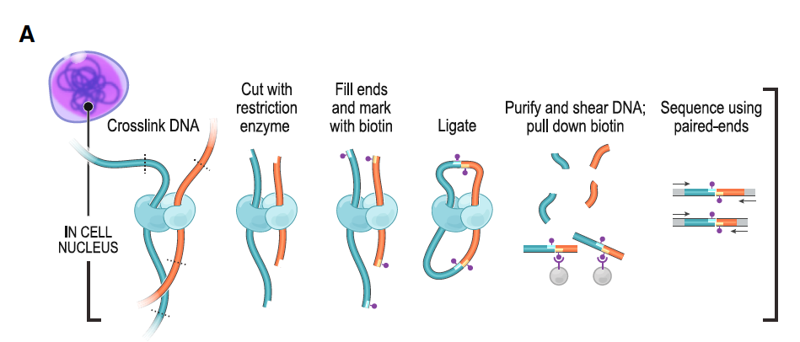
Hi-C
“All versus all”
Biotin labeling before ligation.
High throughput sequencing
Rao et al, 2014. A 3D map of the human genome at kilobase resolution reveals principles of chromatin looping. Cell

Slide 8
ChIP-seq based techniques
Looking specifically at interactions with a protein of interest (e.g CTCF, PolII,...)
ChIP loop
Chip-seq + 3C
ChIA-PET
Chromatin Interaction Analysis
by Paired End Sequencing
ChIP seq + 5C

Slide 9
Interpreting Hi-C data: TADs
A
B
C
D
 | A | B | C | D
A
B
C
D
TAD:

Slide 10
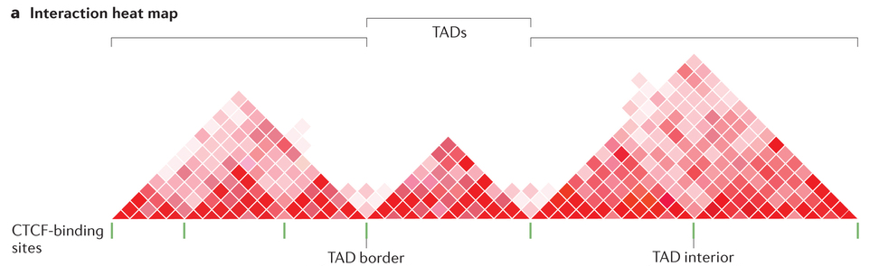
TADs
Area of high chromosomal contacts.
Start and end points of TADs are called “borders”
Regions around borders are called boundaries.
Boundaries are region of high intra-TAD contact that act as insulators, preventing inter-TAD contacts.
TAD boundaries

Slide 11
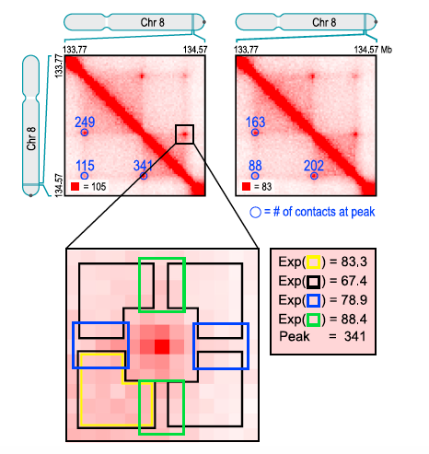
Interpreting Hi-C data: Loops
A
B
C
D
Anchors
 | A | B | C | D
A
B
C
D

Slide 12
Examples of lincRNAs and TAD regulation
Notes:
Looping factors
Gene regulatory elements
ncRNAs
1

Slide 13
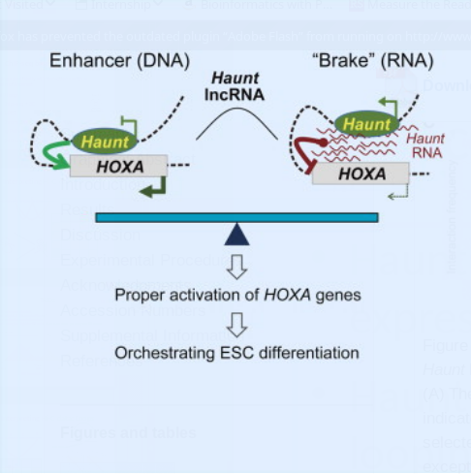
ncRNAs and spatial organization
Haunt: induce/repress HOXA genes expression depending on spatial organization
Haunt RNA is thought to inhibit chromosomal looping by binding HOXA genes.
Haunt DNA acts as enhancer for HOXA genes through chromosomal looping.
Yin Y, Yan P, Lu J, et al. Opposing Roles for the lncRNA Haunt and Its Genomic Locus in Regulating HOXA Gene Activation during Embryonic Stem Cell Differentiation. Cell Stem Cell. 2015;16(5):504-16.

Slide 14
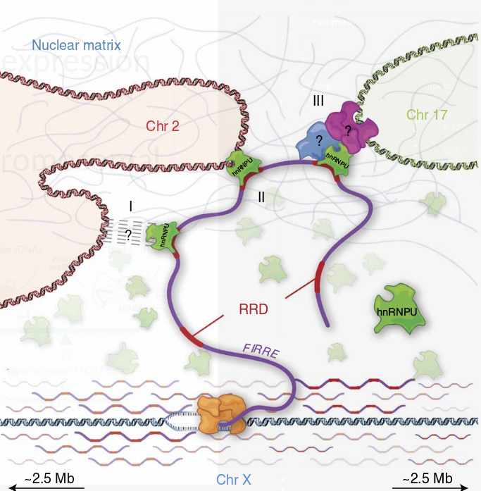
ncRNAs and spatial organization
Firre: lincRNA reorganizing chromosomal architecture.
Anchors the inactive X chromosome to the nucleolus through CTCF/cohesin binding.
Only the locus on the Xi binds CTCF
Transcript is also bound by CTCF
Promotes formation of trans-chromosomal contacts through binding of hnRNPU, a nuclear matrix factor, via a Repeating RNA Domain.
Hacisuleyman E, Goff LA, Trapnell C, et al. Topological organization of multichromosomal regions by the long intergenic noncoding RNA Firre. Nat Struct Mol Biol. 2014;21(2):198-206.
Yang F, Deng X, Ma W, et al. The lncRNA Firre anchors the inactive X chromosome to the nucleolus by binding CTCF and maintains H3K27me3 methylation. Genome Biol. 2015;16:52.

Slide 15
What controls gene regulation in TADs?
Notes:
Looping factors
Gene regulatory elements
ncRNAs
1

Slide 16
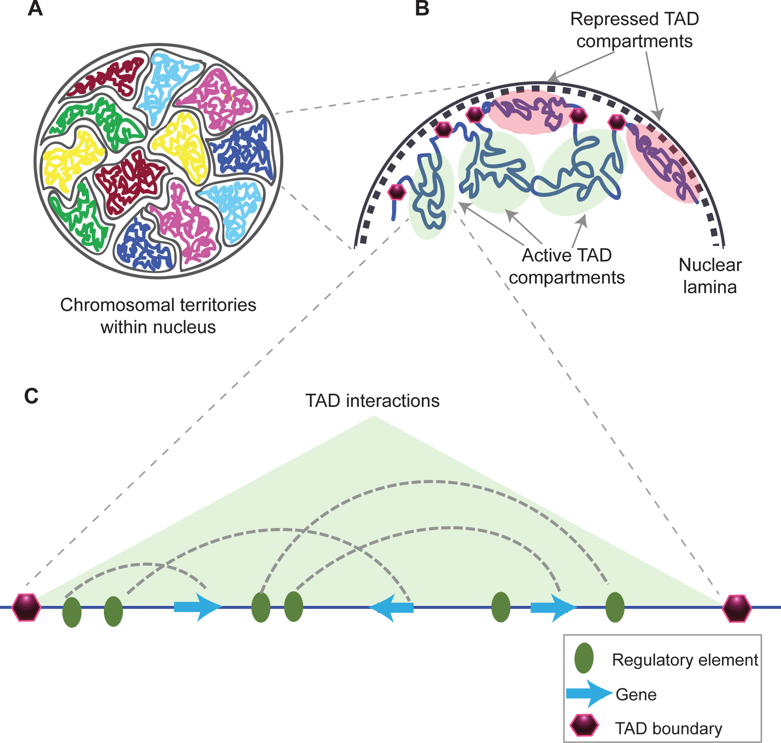
Structural organization of the chromatin
Matharu and Ahituv 2015, PLoS Gen
Notes:
Repressed TADs (repressed transcriptional activity) tend to be associated with the nuclear lamina (part of the inner nuclear membrane)
Active TADs tend to be in nuclear interior
Regulatory interactions within TADs largely determine the transcriptional landscape in the genome
1

Slide 17
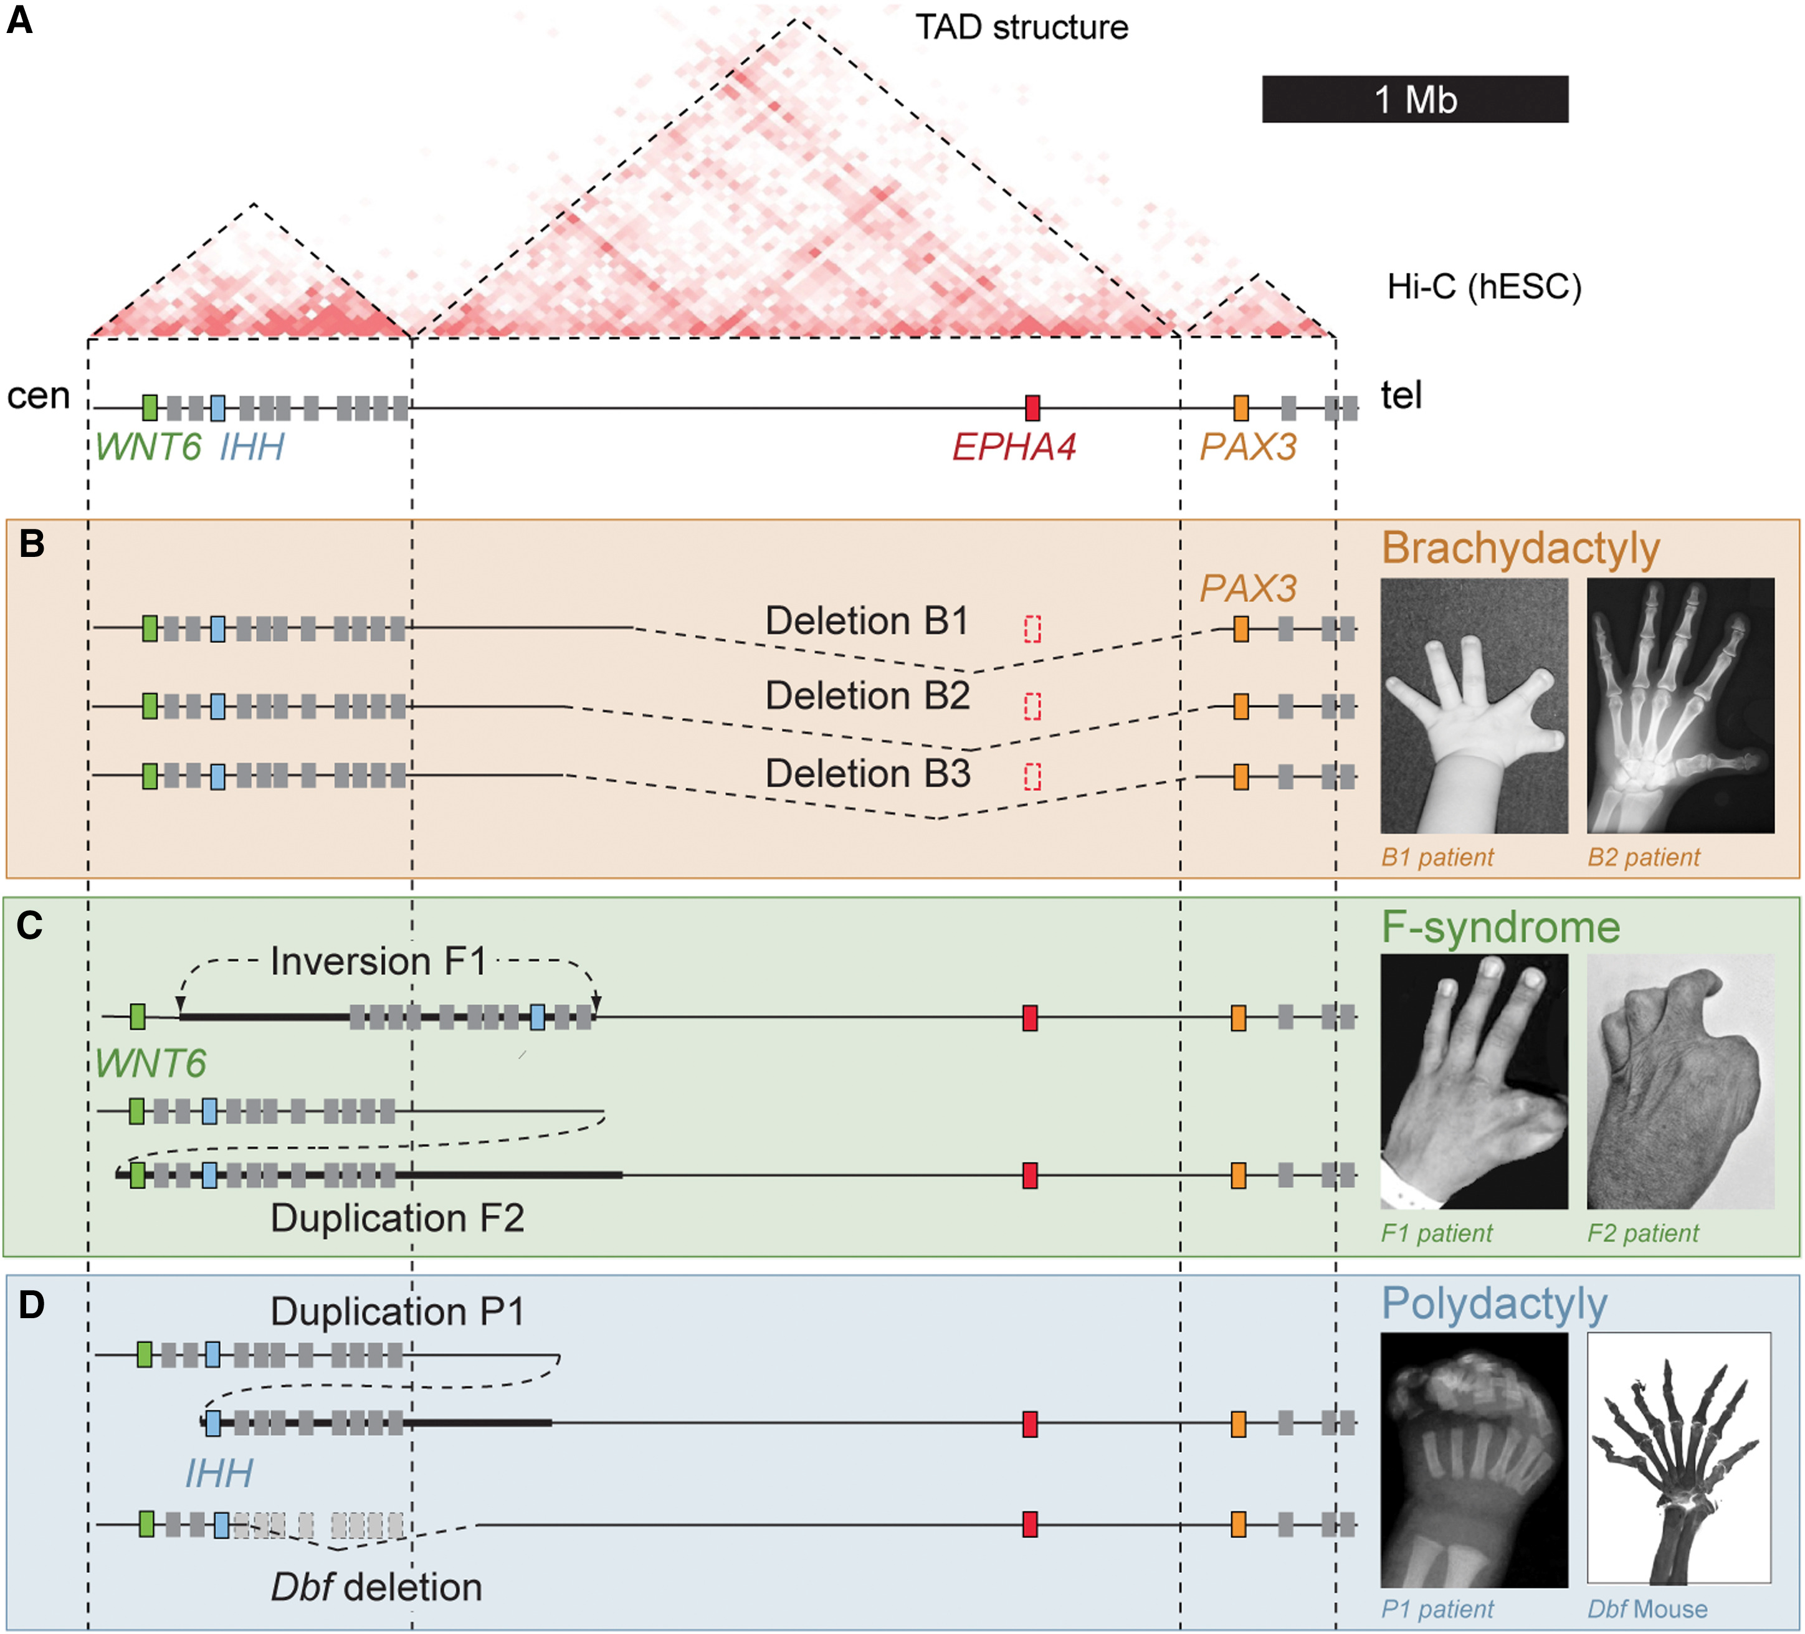
Disruptions of TAD boundaries cause diseases
Lupiáñez et al 2015 Cell
Notes:
EPHA4 – expressed during limb development
Brachydactyly – short digits
Delerion of EPHA4
F-syndrome – fusion of first and second fingers and polydactyly of the feet
DNA rearrangement brings EPHA4-containing TAD closer to WNT6 gene
Polysyndactyly and craniofacial abnormalities
Brings EPHA4-containing TAD closer to IHH gene
Boundary elements at both sides of the EPHA4 TAD prevent ectopic expression of neighbouring genes
EPHA4 enhancer cluster
Different phenotypes can result from one enhancer acting on different target genes
1

Slide 18
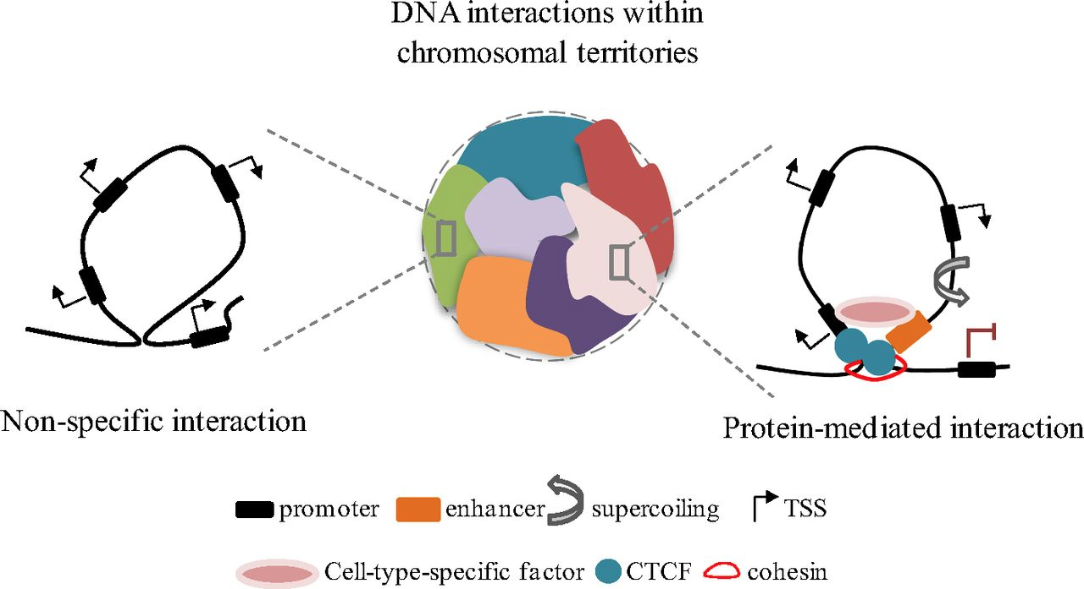
What determines regulatory interactions?
Adapted from Baranello et al PNAS 2014
Notes:
CTCF and cohesin are thought to be important proteins in maintaining or establishing TAD structures
Will come back to the schema in more detail later!
Cohesin-enhancer interactions is also cell-specific
Cell-specific factor, i.e. lincRNAs?
1

Slide 19
CTCF and Cohesin
CTCF:
CCCTC-binding factor
Highly conserved TF
Involved in transcription repression and/or activation by regulating chromatin architecture
Enriched at TAD boundaries
Often thought to act as insulators: prevent interactions across TADs
Notes:
1

Slide 20
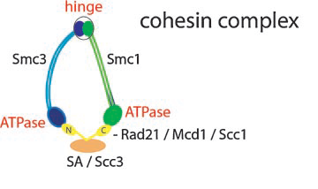
CTCF and Cohesin
CTCF:
CCCTC-binding factor
Highly conserved TF
Involved in transcription repression and/or activation by regulating chromatin architecture
Enriched at TAD boundaries
Cohesin:
Multi-protein complex ring structure
Keeps sister chromatids connects during metaphase in mitosis
DNA repair
Enriched at TAD boundaries
Notes:
1

Slide 21
CTCF and Cohesin
CTCF
Delimit boundaries between TADs
Often thought to act as insulators: prevent interactions across TADs
Cohesin
Two types of cohesin binding:
CTCF
relatively conserved across cell types and species
Active enhancer/promoter elements
cell type-specific
Notes:
1

Slide 22
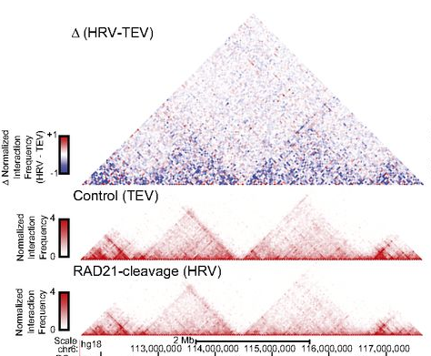
Cohesin and CTCF have different effects on chromatin architecture and gene expression
Cohesin disruption – cleavable RAD21 replacement
Depleted intra-chromosomal interactions
Zuin et al PNAS 2014
Notes:
1

Slide 23
Cohesin and CTCF have different effects on chromatin architecture and gene expression
Cohesin disruption – cleavable RAD21 replacement
CTCF knockdown
Depleted intra-chromosomal interactions
Depleted intra-chromosomal interactions
+ Increased inter-chromosomal interactions
Zuin et al PNAS 2014
Notes:
1

Slide 24
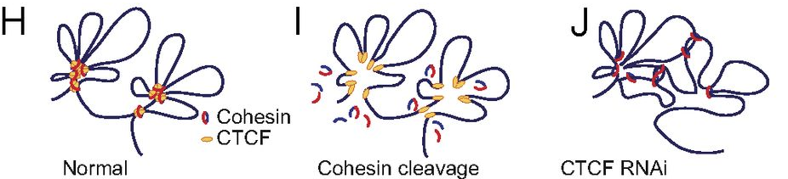
Cohesin and CTCF have different effects on chromatin architecture and gene expression
Zuin et al PNAS 2014
Notes:
Proposed model
1

Slide 25
CTCF and Cohesin
Two types of cohesin binding:
CTCF (relatively conserved across cell types and species)
Active enhancer/promoter elements (cell type-specific)
Notes:
Looping factors
Gene regulatory elements
ncRNAs
1

Slide 26
CTCF and Cohesin
Two types of cohesin binding:
CTCF (relatively conserved across cell types and species)
Active enhancer/promoter elements (cell type-specific)
Reflect dynamic transcription state of different cell types!!!
Notes:
Looping factors
Gene regulatory elements
ncRNAs
1

Slide 27
What determines regulatory interactions?
Adapted from Baranello et al PNAS 2014
Notes:
CTCF and cohesin are thought to be important proteins in maintaining or establishing TAD structures
Will come back to the schema in more detail later!
Cohesin-enhancer interactions is also cell-specific
Cell-specific factor, i.e. lincRNAs?
1

Slide 28
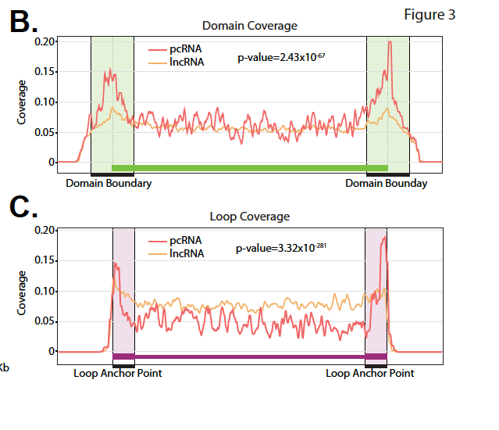
Enrichment of lncRNAs at TAD boundaries
Topological anchor point (tap)RNAs
Positionally conserved, not sequence conserved
Amaral et al 2016 bioRxiv
Notes:
1

Slide 29
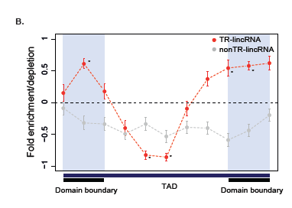
TR-lincRNAs are enriched at TAD boundaries
Notes:
1

Slide 30
TR-lincRNAs are enriched in cohesin binding
elincRNAs are enriched in cohesin binding (Cyril’s data)
fold enrichment = 13.1
p = 1E-04
TR-lincRNA also enriched in cohesin binding
fold enrichment = 2.48
p = 0.01
relative to all expressed lincRNAs (excluding elincRNAs)
TR-lincRNA depleted in CTCF binding
regardless of whether workspace contains elincRNAs or not
Notes:
1

Slide 31
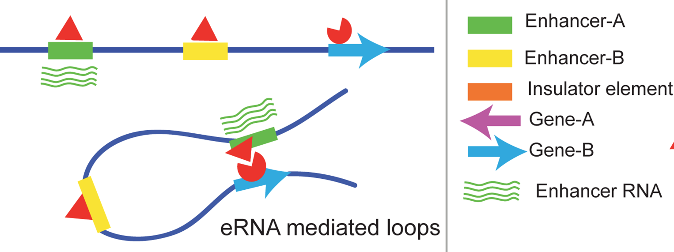
Hypothesis?
CTCF
Cohesin
Adapted from Matharu and Ahituv 2015, PLoS Gen
Notes:
1

Slide 32
That’s not all, there are more…
Notes:
1

Slide 33
Meta-TADs
Notes:
Looping factors
Gene regulatory elements
ncRNAs
1

Slide 34
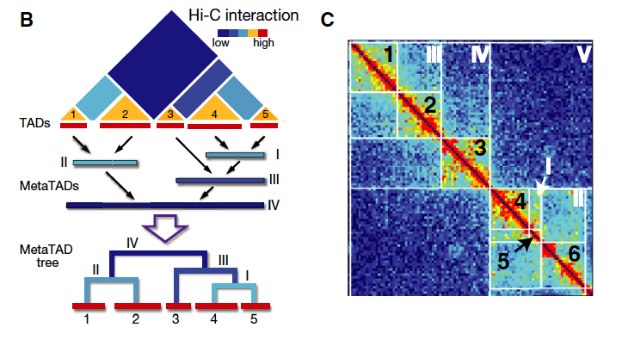
Meta-TADs
Fraser et al 2015 Mol Sys Biol
Notes:
1

Slide 35
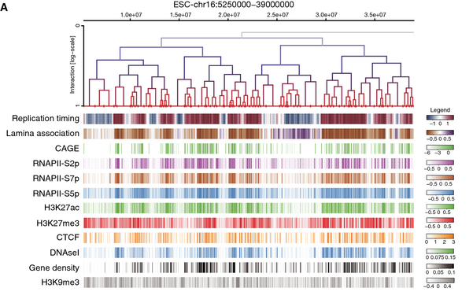
Meta-TADs hierarchy correlates with epigenomic features
Fraser et al 2015 Mol Sys Biol
Notes:
Looping factors
Gene regulatory elements
ncRNAs
1

Slide 36
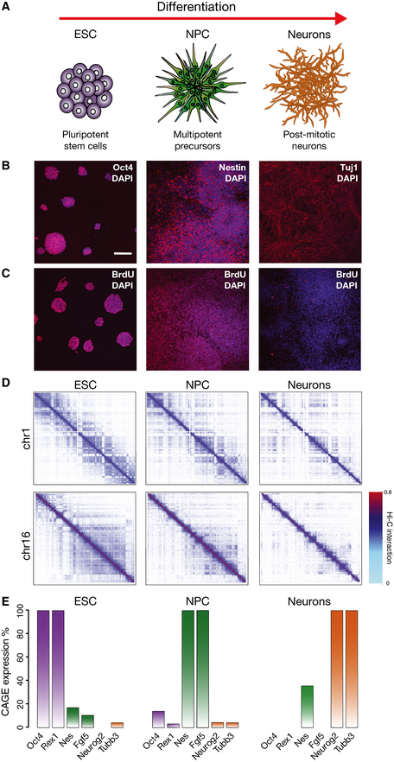
Changes in metaTAD architecture and gene expression across differentiation
Fraser et al 2015 Mol Sys Biol
Notes:
NPC – neuronal pregenitor cells
Early differentiation stage (ESC -> NPC) is associated with more dynamic restructuring of TAD-TAD contacts
And more gene expression changes
1

Slide 37
TAD boundaries are relatively conserved across differentiation
74-80% of TAD boundary positions conserved across differentiation
Changes (~60%) in metaTAD structures that’s associated with changes in gene expression!
Fraser et al 2015 Mol Sys Biol
Notes:
1

Slide 38
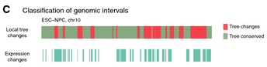
Changes in metaTAD structure associated with
gene expression changes
Gene expression changes also occur within conserved TADs
Authors reason this is to accommodate for changes in local metaTAD??
Fraser et al 2015 Mol Sys Biol
Notes:
1

Slide 39
Issues with current technolgy…
Low resolution
Only captures average contacts in a sample
DNA in solution forms “artificial contacts
In-situ Hi-C (ligation performed in intact nuclei)
Notes:
Looping factors
Gene regulatory elements
ncRNAs
1

Slide 40
Ambiguous definitions
What amount of contact required to call a loop?
TADs are embedded in larger TADs.
Dynamic structures are hidden by Hi-C
Interest of single-cell Hi-C

Slide 41
Thoughts…
Notes:
Looping factors
Gene regulatory elements
ncRNAs
1

Slide 42
Disruptions of TAD boundaries cause diseases
Lupiáñez et al 2015 Cell
Notes:
EPHA4 – expressed during limb development
Brachydactyly – short digits
Delerion of EPHA4
F-syndrome – fusion of first and second fingers and polydactyly of the feet
DNA rearrangement brings EPHA4-containing TAD closer to WNT6 gene
Polysyndactyly and craniofacial abnormalities
Brings EPHA4-containing TAD closer to IHH gene
Boundary elements at both sides of the EPHA4 TAD prevent ectopic expression of neighbouring genes
EPHA4 enhancer cluster
Different phenotypes can result from one enhancer acting on different target genes
1

Slide 43
Ideas?
Look for CNVs overlapping TR-lincRNAs?
Potentially lead in disease phenotypes similar to eQTL trait
Through:
mis-folding of chromatin?
Breaking TAD boundary?
Forming neo-TADs? (i.e. like in Franke et al 2016 Nature)
Mis-regulating of enhancer-promoter interactions?
Notes:
EPHA4 – expressed during limb development
Brachydactyly – short digits
Delerion of EPHA4
F-syndrome – fusion of first and second fingers and polydactyly of the feet
DNA rearrangement brings EPHA4-containing TAD closer to WNT6 gene
Polysyndactyly and craniofacial abnormalities
Brings EPHA4-containing TAD closer to IHH gene
Boundary elements at both sides of the EPHA4 TAD prevent ectopic expression of neighbouring genes
EPHA4 enhancer cluster
Different phenotypes can result from one enhancer acting on different target genes
<number>

